Slide 1
Floyd – Warshall Algorithm
Lecture on

Slide 2
What is Floyd – Warshall Algorithm?
Floyd-Warshall algorithm is a graph analysis algorithm for finding shortest path in a weighted graph with positive or negative edge weights.

Slide 3
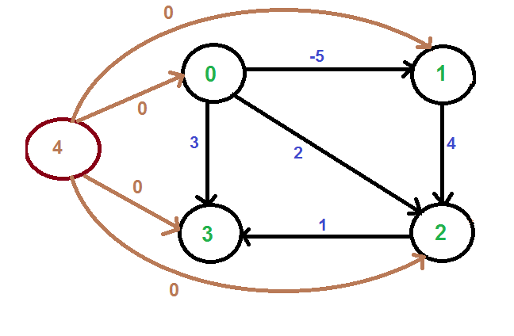
Still Don’t Understand?
Its just a simple method to find out the shortest path from the initial point to the destination using shortest pairs.

Slide 4
Characteristics
It should be a directed graph
Problem is solved using matrix
The matrix should be a square matrix

Slide 5
Developing Adjacency Matrix
Now we are going to develop adjacency matrix.

Slide 6
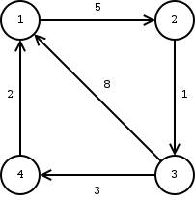
Developing Adjacency Matrix
To develop an adjacency matrix from the given graph using the nodes and the edges, first take out the nodes and make a square matrix using them.
1 2 3 4
1
2
3
4

Slide 7
Developing Adjacency Matrix
Then apply the value of edges.
1 2 3 4
1 0 5 ∞ ∞
2
3
4

Slide 8
Developing Adjacency Matrix
Then apply the value of edges.
1 2 3 4
1 0 5 ∞ ∞
2 ∞ 0 1 ∞
3
4

Slide 9
Developing Adjacency Matrix
Then apply the value of edges.
1 2 3 4
1 0 5 ∞ ∞
2 ∞ 0 1 ∞
3 8 ∞ 0 3
4

Slide 10
Developing Adjacency Matrix
Then apply the value of edges.
1 2 3 4
1 0 5 ∞ ∞
2 ∞ 0 1 ∞
3 8 ∞ 0 3
4 2 ∞ ∞ 0

Slide 11
Arranging matrix and calculate
Now we are going to arrange the matrix and calculate them.

Slide 12
Arranging R1
Original Matrix
R1
1 2 3 4
1 2 3 4
1 0 5 ∞ ∞
2 ∞ 0 1 ∞
3 8 ∞ 0 3
4 2 ∞ ∞ 0
1 0 5 ∞ ∞
2 ∞
3 8
4 2

Slide 13
Arranging R1
Original Matrix
R1
1 2 3 4
1 2 3 4
1 0 5 ∞ ∞
2 ∞ 0 1 ∞
3 8 ∞ 0 3
4 2 ∞ ∞ 0
1 0 5 ∞ ∞
2 ∞ 0 1 ∞
3 8 13 0 3
4 2 7 ∞ 0

Slide 14
Arranging R2
Original Matrix
R2
1 2 3 4
1 2 3 4
1 0 5 ∞ ∞
2 ∞ 0 1 ∞
3 8 13 0 3
4 2 7 ∞ 0
1 5
2 ∞ 0 1 ∞
3 13
4 7

Slide 15
Arranging R2
Original Matrix
R2
1 2 3 4
1 2 3 4
1 0 5 ∞ ∞
2 ∞ 0 1 ∞
3 8 13 0 3
4 2 7 ∞ 0
1 0 5 6 ∞
2 ∞ 0 1 ∞
3 8 13 0 3
4 2 7 8 0

Slide 16
Arranging R3
Original Matrix
R3
1 2 3 4
1 2 3 4
1 0 5 6 ∞
2 ∞ 0 1 ∞
3 8 13 0 3
4 2 7 8 0
1 6
2 1
3 8 13 0 3
4 8

Slide 17
Arranging R3
Original Matrix
R3
1 2 3 4
1 2 3 4
1 0 5 6 ∞
2 ∞ 0 1 ∞
3 8 13 0 3
4 2 7 8 0
1 0 5 6 9
2 14 0 1 4
3 8 13 0 3
4 2 7 8 0

Slide 18
Arranging R4
Original Matrix
R4
1 2 3 4
1 2 3 4
1 0 5 6 9
2 14 0 1 4
3 8 13 0 3
4 2 7 8 0
1 9
2 4
3 3
4 2 7 8 0

Slide 19
Arranging R4
Original Matrix
R4
1 2 3 4
1 2 3 4
1 0 5 6 9
2 14 0 1 4
3 8 13 0 3
4 2 7 8 0
1 0 5 6 9
2 6 0 1 4
3 5 10 0 3
4 2 7 8 0

Slide 20
Arrangement Done!

Slide 21
Final Matrix
1 2 3 4
1 0 5 6 9
2 6 0 1 4
3 5 10 0 3
4 2 7 8 0

Slide 22
Examining with graph
1 2 3 4
1 0 5 6 9
2 6 0 1 4
3 5 10 0 3
4 2 7 8 0

Slide 23
That’s All about Floyd–Warshall Algorithm
Thank You!

